Slide 1

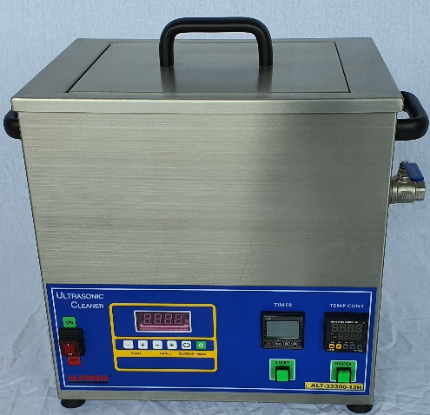
ALT Series Ultrasonic Cleaner
ALT-2545-300-12H
Alstron ALT Series Ultrasonic Cleaner provides a comprehensive range of units tailored for industrial part cleaning. Applications cover degreasing and removing contaminants from various components including marine vessels, aerospace parts, PCBs, machining parts, mechanical components (pre-coating or plating), optical parts, surgical instruments, 3D modeling, R&D, and more.
Signature Frequency 2545kHz for General Cleaning Applications
Internal Tank - Stainless Steel SS316L, External Tank - SS304 Construction
Adjustable Digital Timer for Ultrasonic Duration Control
Digital Temperature Controller for Heating Control
Sweeping Function & Adjustable Ultrasonic Power Intensity
PLL Technology with Auto-Frequency Tracking & Adjustment
Strong Holding Basket in SS316, 1 square-inch Mesh
Power Input: AC 220 – 240V, Single-Phase
Water Drainage Piping & Valve in SS316
Model | ALT-2545-300-12H
Functional
Frequency (kHz) | 2545
Capacity (Litres) | 12
Ultrasonic Power (Watts) | 300
Sweeping Function | Yes
Power Intensity | 10 - 100% Adjustable
Timer Function | 1 - 60 mins / Infinity
Heater Power (Watts) | 600
Temperature Sensor Type | PT100
Temperature Range (Celsius) | 20 – 70 °C
Connected Power (Ampere) | 13
Input Power | AC 220 – 240 V, Single Phase, 50/60Hz
Programmable HMI (Touchscreen) | Not Applicable
Physical
Internal Tank Dimension L x W x H (mm) | 305 x 250 x 170
Overall External Tank Dimension w/o Valve (mm) | 427 x 292 x 455
Internal Tank Material | SS316L
External Tank Material | SS304
Net Weight (kg) | 19.6
Drainage Valve Material | SS316, 3/4 Inch Full Ball Valve
Power Cable Length | 3m with Quick Connector and UK Plug
Basket
Basket Internal Dimension L x W x H (mm) | 275 x 220 x 100
Basket Material | SS316L
Mesh Grid Size (mm²) | 25 x 25
Optional
High Density Basket Model | ABK-2545-300-01
Mesh Grid Size (mm²) | 5 x 5
www.alstron.com.sg sales.sg@alstron.com.sg

